Slide 1
IST 3420: Introduction to Data Science and Management
1. Introduction to Data Science

Slide 2
Agenda
What is data science?
Big data
Work as a data scientist
Ethical conduct in data science

Slide 3
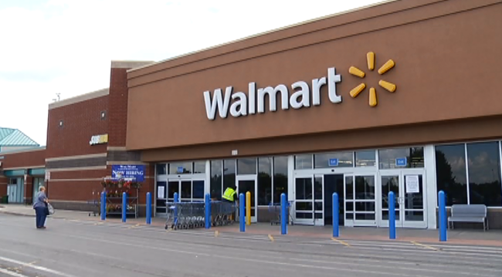
Walmart Case: What They Know About You
Event
Hurricane Frances was threatening Florida's Atlantic coast
Intuition
The demand for flashlights would increase in local stores
Data Science Approach
Use predictive technology to see what’s going to happen based on historical data
Findings (Hidden Patterns)
''We didn't know in the past that strawberry Pop-Tarts increase in sales, like seven times their normal sales rate, ahead of a hurricane,'' Ms. Dillman said in a recent interview. ''And the pre-hurricane top-selling item was beer.''
Notes:
The Walmart case shows a very interesting story in which Walmart used data science approach to predict what’s going to happen when a hurricane was coming.
Based on intuition, what we know is that the demand for flashlights would increase. This is obvious, everyone knows that. The question is, is there any knowledge that we cannot get immediately from human intuition?
Every time when you buy some goods from Walmart, Walmart records every piece of information. With the wealth of data that Walmart has accumulated, Walmart applied data science methods to analyze their data. And they found some hidden patterns from the data.

Slide 4
What is Data Science?
https://en.wikipedia.org/wiki/Data_science
Data science is an interdisciplinary field about processes and systems to extract knowledge or insights from data in various forms, either structured or unstructured, which is a continuation of some of the data analysis fields such as statistics, data mining, and predictive analytics, similar to Knowledge Discovery in Databases (KDD).
“Data” means dealing with every aspects of data such as collecting data, cleansing data, transforming data, and analyzing data.
“Science" means extracting knowledge through systematic approach
A briefer definition: “Data science is the study of the generalizable extraction of knowledge from data.” (Dhar 2013)
Notes:
On Wikipedia, data science is defined as....
Basically, data science is comprised of two parts: the “data” part, and the “science” part. The “data” part means we deal with every aspects of data such as collecting data, cleansing data, transforming data, and analyzing data.
The “science” part of data science is especially important. “Science" means extracting knowledge through systematic approach.
In brief, we can define data science as ....

Slide 5
Data Science vs. Business Analytics
The boundary between Data Science and Business Analytics is blurry.
For a comparison, refer to https://onlinebusiness.american.edu/blog/comparing-analytics-data-science/
In this course, we use the two terms interchangeably.
Notes:
In some schools, we call it data science. In other schools, we call it “business analytics”.

Slide 6

Overview of Analytics (INFORMS taxonomy)
What happened?
Prepares and analyzes historical data
Identifies patterns from samples for reporting of trends
Visualization
Report
Dashboard
…
Descriptive Analytics
What will happen?
Predicts future probabilities and trends
Finds relationships in data that may not be readily apparent with descriptive analysis
Data mining
Forecasting
Statistical analysis
Machine learning
…
Analytics
Predictive Analytics
How can we make it happen?
Evaluates and determines new ways to operate
Targets business objectives
Balances all constraints
Optimization
Simulation
Decision modeling
…
Prescriptive Analytics
The Institute for Operations Research and the Management Sciences (INFORMS) is the largest society in the world for professionals in the field of operations research (O.R.), management science, and analytics.
Source: https://www.informs.org/Community/Analytics
Notes:
INFORMS stands for institute for operations research and the management science.
According to INFORMS, data science or analytics can be categorized into 3 major types.

Slide 7
Data Science/Analytics Procedures

Slide 8










Data Science/Analytics Tools
Open source
Commercial

Slide 9
Agenda
What is data science?
Big data
Work as a data scientist
Ethical conduct in data science

Slide 10

Decision Making When There Is No Data
Cannot use data (evidence) to support your belief (theory)
He Loves Me, He Loves Me Not. ----Giacomo Di Chirico, 1872

Slide 11
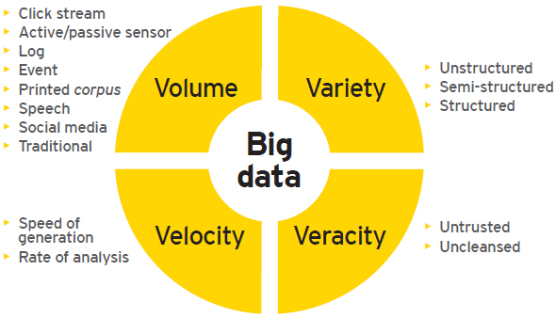
The Era of Big Data
Big data
Data sets with characteristics beyond the ability of commonly used software tools to capture, curate, manage, and process data within a tolerable elapsed time.
4Vs Model
Image source: http://www.ey.com/GL/en/Services/Advisory/EY-big-data-big-opportunities-big-challenges

Slide 12
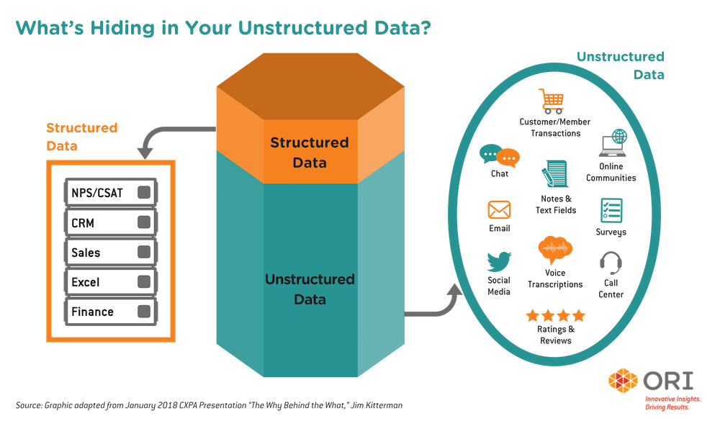
Structured Data vs Unstructured Data

Slide 13


Limitations of Relational DBMS
RDBMS
Bases on E.F. Codd model
Provides good support for ACID (Atomicity, Consistency, Isolation and Durability)
Limitations to deal with big data
Scalability: expensive and hard to scale
Complexity: data fit into a predefined schema (table structure)
Performance/Speed: data join is very time consuming
Notes:
Why the concept of “big data” was proposed? One major reason is the limitations of a relational database management system.

Slide 14
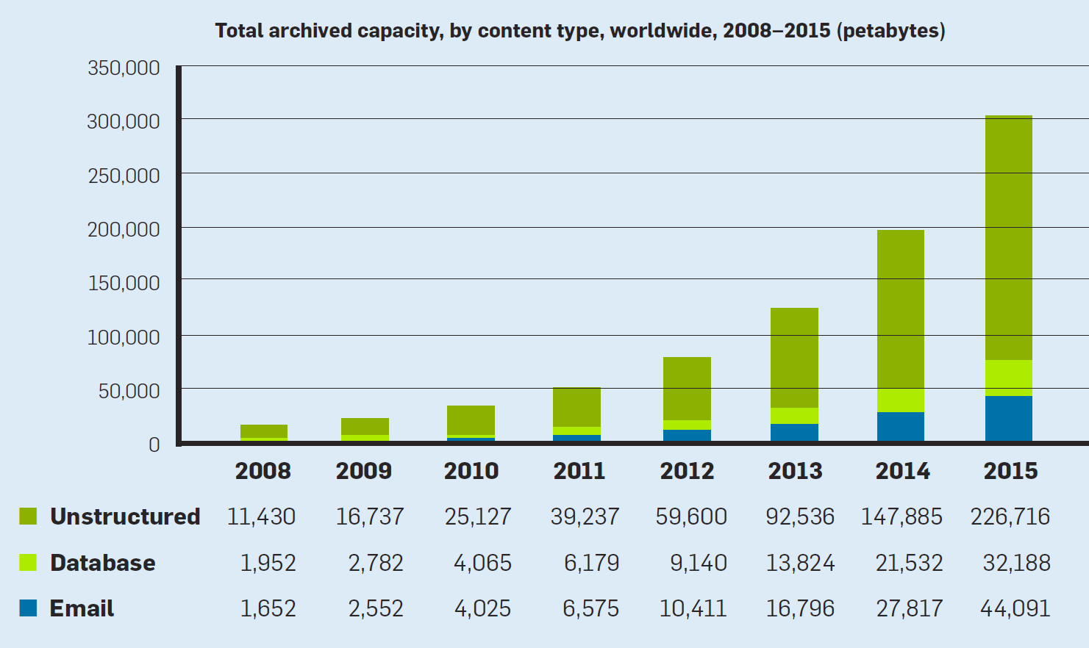
Projected growth of unstructured & structured data (Dhar 2013)

Slide 15
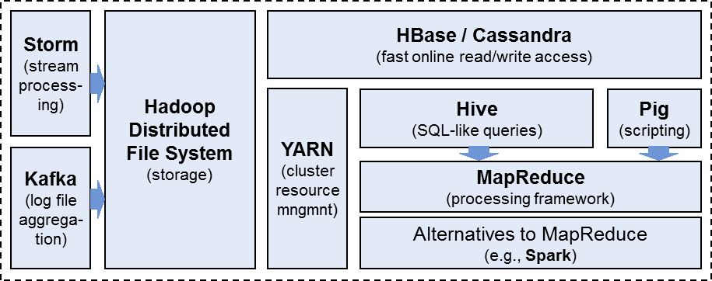
Big Data Ecosystem
To better handle big data, many technologies have been proposed. These technologies form the big data ecosystem.
The big data ecosystem provides a framework for handling big data in the whole process, from big data processing to big data storage, to big data analytics.
Source: http://blogs.gartner.com/martin-kihn/what-marketers-should-know-about-big-data/

Slide 16

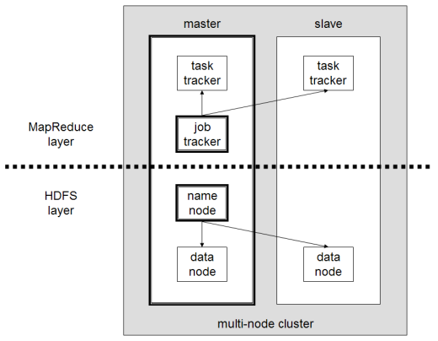
Hadoop
An open-source framework for distributed storage and distributed processing of very large data sets on computer clusters built from commodity hardware
Based on the idea of Google File System
Consists of two main layers
Hadoop distributed file system (HDFS)
MapReduce: processing engine
Hadoop Design Principles
Process big data in parallel
Run on cheap commodity hardware
Be fault-tolerant and robust (self-healing)
Notes:
Hadoop might be the most well-known technology in the big data ecosystem.

Slide 17
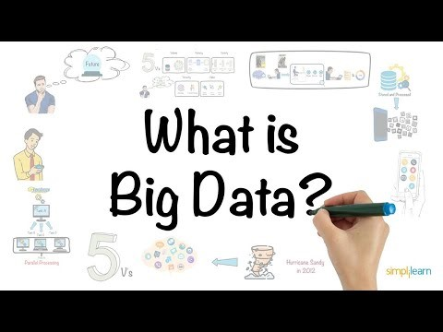
Video: Big Data and Hadoop

Slide 18
Agenda
What is data science?
Big data
Work as a data scientist
Ethical conduct in data science

Slide 19
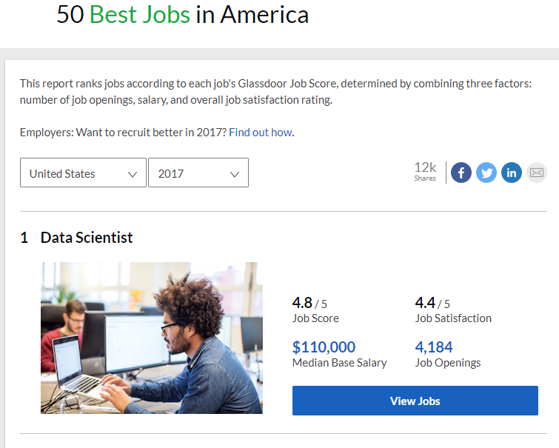
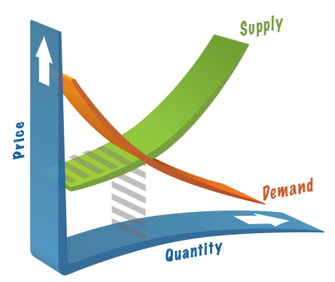
Data Scientist: the “Sexist” Job of the 21st Century
Top 1 in 50 best jobs in America (2017)
Image source
http://precision-market-research.com/supply-demand/
https://www.glassdoor.com/List/Best-Jobs-in-America-LST_KQ0,20.htm

Slide 20
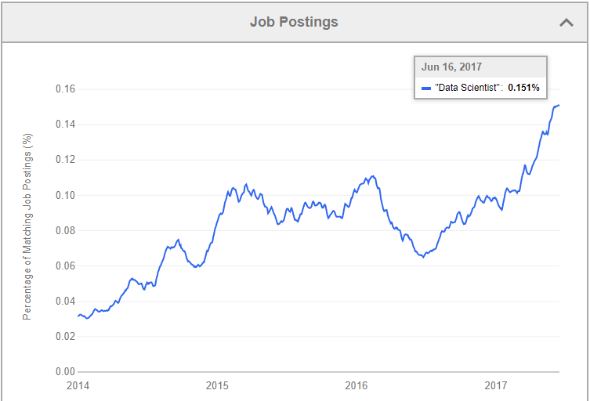
Data Scientist Job Trend
Source: http://www.indeed.com/jobtrends/q-%22Data-Scientist%22.html
Notes:
https://www.import.io/post/why-data-scientist-is-being-called-the-sexiest-job-of-the-21st-century/
Eventually, with the rise of University programs teaching data science, the supply of data scientists will catch up with the demand and salaries will level out. But in the meantime – stay sexy guys!

Slide 21
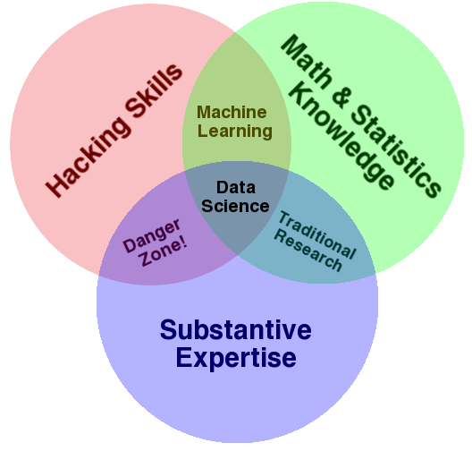

Skill Set for BA/Data Science
Hacking Skills
Programming (R and Python), data structures, markup languages, algorithms, database, cloud computing, big data etc.
Math and Statistics Knowledge
Probabilities, distributions, hypothesis testing, multivariate analyses, econometrics etc.
Prediction, classification, clustering, text mining etc.
Curiosity and Expertise
Academic curiosity, domain knowledge, storytelling, visualization, product sense etc.

Slide 22
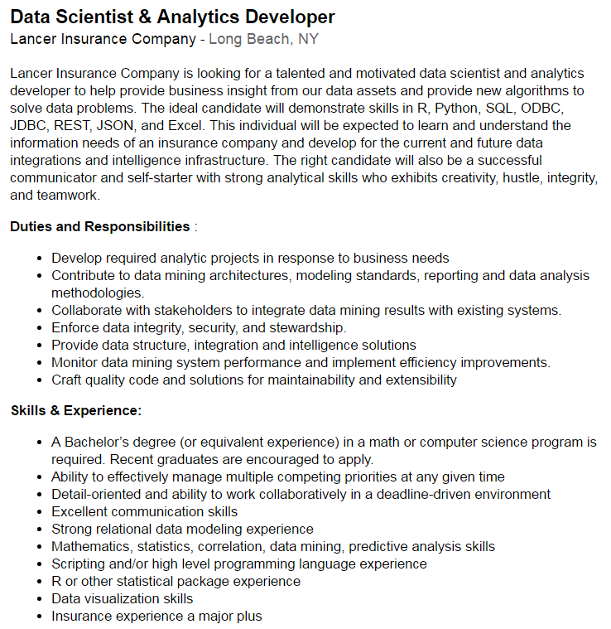

A Sample Job Description
http://www.indeed.com/cmp/Lancer-Insurance-Company/jobs/Data-Scientist-Analytic-Developer-60daa4cc2519aa23 [Access on 6/26/2016]

Slide 23
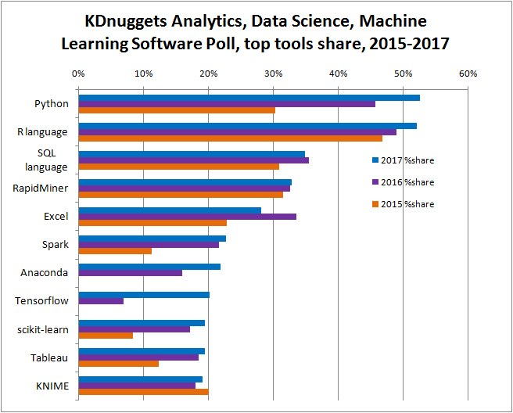
Top Tools for Data Science/Analytics (2015-2017)
To learn Python, choose “IST 5520 – Data Science and Machine Learning with Python” offered in Spring.
http://www.kdnuggets.com/2017/05/poll-analytics-data-science-machine-learning-software-leaders.html

Slide 24
Agenda
What is data science?
Big data
Work as a data scientist
Ethical conduct in data science

Slide 25
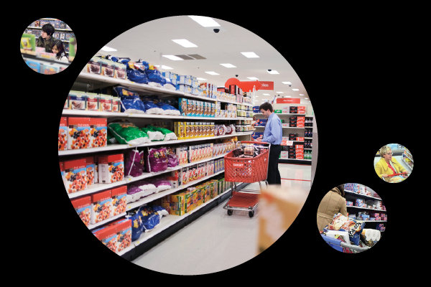
Ethical Issues in Data Science
Business case: Target's customer tracking technology
“How Companies Learn Your Secrets”. Refer to http://www.nytimes.com/2012/02/19/magazine/shopping-habits.html?_r=2&hp=&pagewanted=all

Slide 26

Facebook-Cambridge Analytica Data Scandal
Cambridge Analytica, a British political consulting firm, began collecting data of Facebook users in 2014 to build psychographic models of those users.
Only about 270,000 users had consented to share their data (such as public profile, birthday, current city) only for academic use.
However, Facebook allowed the share of the information of those users’ friends. Around 50 millions Facebook users were involved in the data breach.

Slide 27
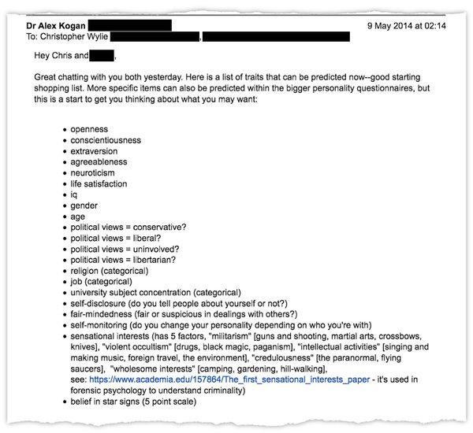
Facebook-Cambridge Analytica Data Scandal
Cambridge Analytica used information from the data breach to attempt to influence public opinion. The data were used for political events such as:
2015 and 2016 campaigns of US politicians
2016 Brexit vote
2018 Mexican general election
An email from Dr. Kogan to Mr. Wylie describing personal traits that could be predicted.
Source: https://www.nytimes.com/2018/03/17/us/politics/cambridge-analytica-trump-campaign.html

Slide 28
Other Potential Pitfalls in Data Science
Bias in the algorithm itself or the data trained to use the model
Algorithmic biases
Encoded biases
Sample biases
Prejudicial Biases
Measurement Bias
Sample bias in statistics is a bias in which a sample is collected in such a way that some members of the intended population are less likely to be included than others
Facial recognition algorithms: recognizing Asian and African-American faces
Amazon recruitment AI: hire more men than women

Slide 29
Standards of Professional Conduct
Legal, policy, and ethical concerns can arise in any steps of data science including data collection, storage, and analysis
Some organizations such as Data Science Association start to create standards of conduct
http://www.datascienceassn.org/code-of-conduct.html

Slide 30
Mitigate Ethical Issues in Data Science Project
Demonstrate compliance with all relevant laws and regulations
Identify all sensitive data and ensure they are secured
Collect minimal data
If 100 data points have sufficient power to detect the pattern, you don’t need one million data points.
Aggregate data
Instead of focusing on each individual, analyze at the level of user groups.

Slide 31
Q & A

